Slide 1
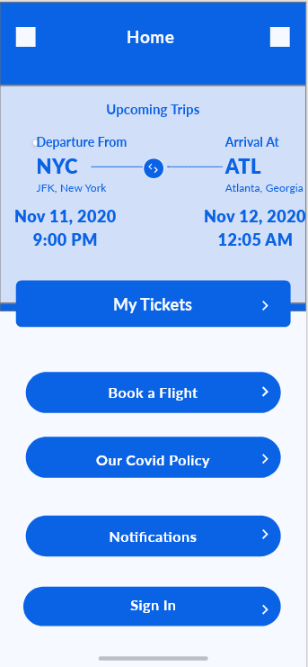
The home/landing page that the user is greeted with
Any booked tickets/upcoming trips are displayed at the top
The page has a button to take the user to their booked tickets
A button to take them to the booking page
A button to read the covid policy of the airline
A button to access all notifications about their flight/bookings
A sign in option so previous info is saved

Slide 2
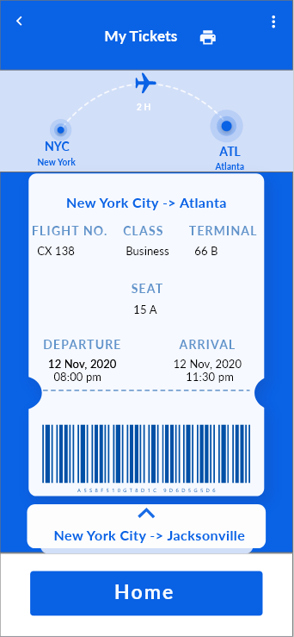
The three buttons top right allow the user to access a navigation menu (shown later)
User can use the back arrow to return to the previous page
The printer icon is a button that allows the user to download the tickets to their device for printing
My tickets pages displays bought tickets, allows for scrolling to access other tickets
User can use the home button at the bottom to return to the home page

Slide 4
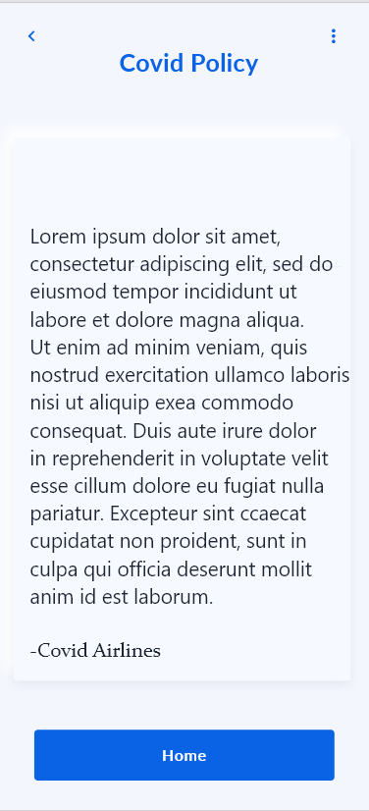
Airline covid policy would be displayed here

Slide 6
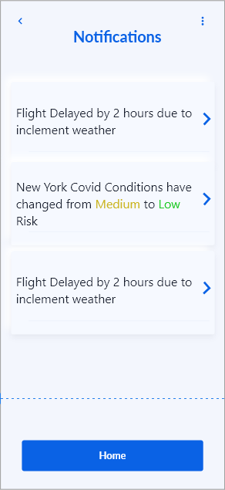
Any and all notifications about the flight or bought tickets displayed here

Slide 8
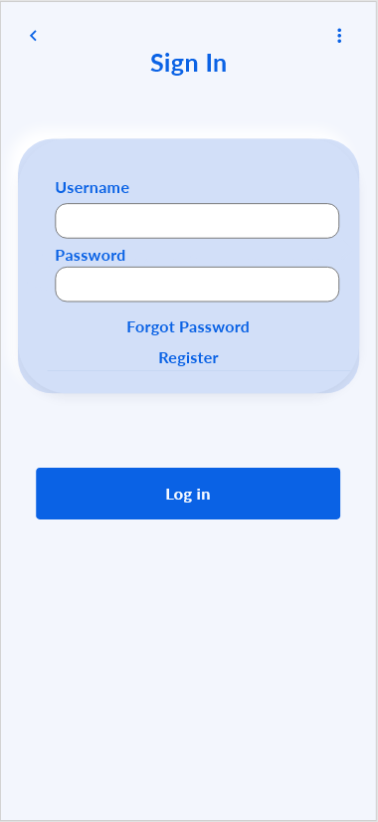
Sign in page for users to input login information
Pressing “Log In” will return the user to the home page
After logging in the sign in button will turn to sign out on the home page

Slide 9
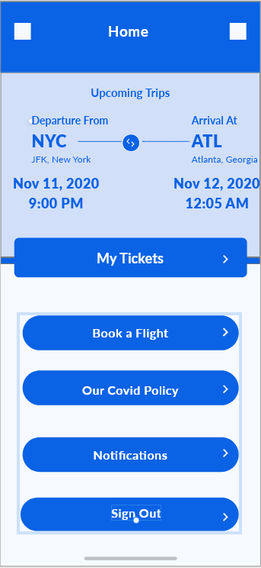
Sign in button has changed to sign out after logging in

Slide 10
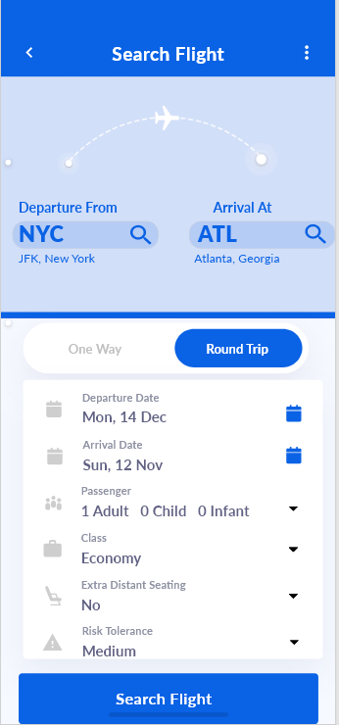
Users can press on the search button icons and input a destination

Slide 11
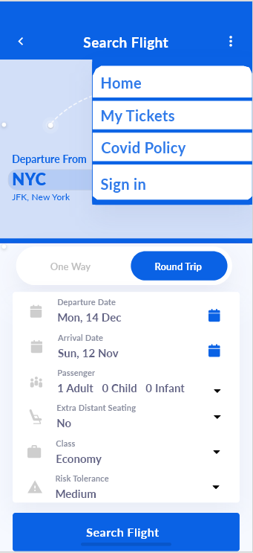
The navigation menu displayed to the user so they can access the home page functions at any point

Slide 12
Users can input the dates for departure and arrival, along with other information for their trip

Slide 13
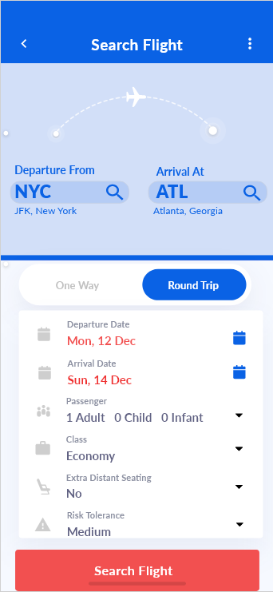
Input fields for booking the trip, if the dates do not comply with quarantine restrictions the dates will be highlighted red and so will the search flight button

Slide 14
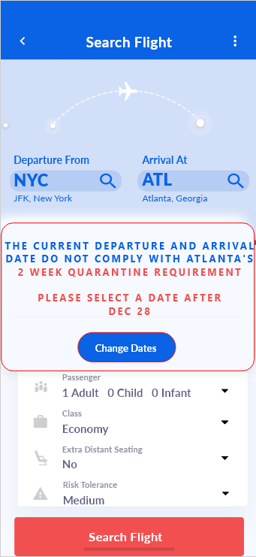
Pop up notification telling the user that the dates are not possible, prompts the user to change dates based off the departure date

Slide 15
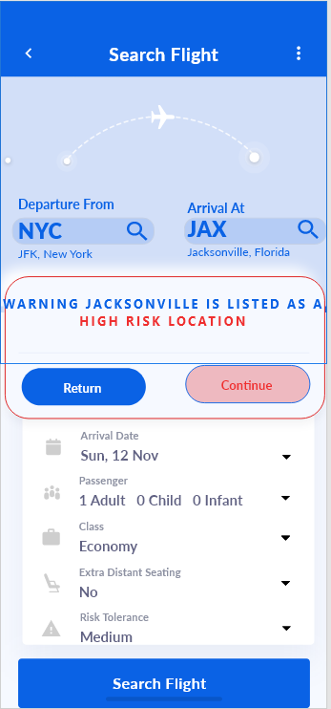
Pressing return allows the user to change any previous fields to adjust to their needs
If the user presses the “Search Flight” button and their risk tolerance does not work with the destination, they will be prompted with a pop up notifying them.
Pressing continue takes them to the flight page.

Slide 16
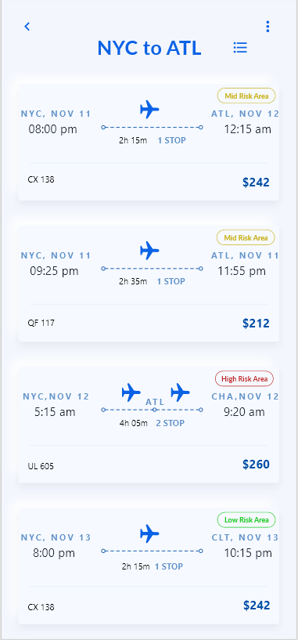
A filter button is at the top that allows for results to be filtered by price, risk, and layovers
Users are show flight cards with information about the flights which they can click to proceed in the flight booking process
The flight icons display differently based on the number of stops with the airport abbreviation located on top of the stop icon

Slide 17
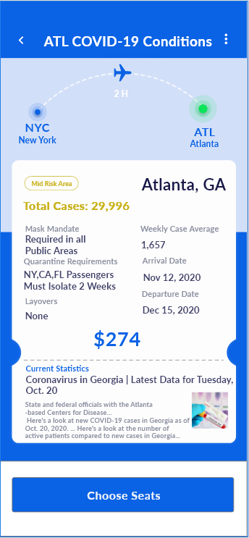
Pressing a flight card takes the user to a page with current covid conditions of the area
The city whose conditions are being shown is highlighted green in the plane diagram

Slide 19
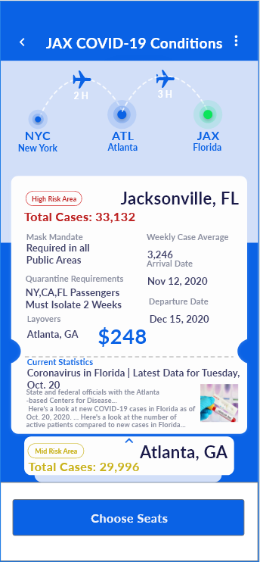
Pressing a flight card with multiple stops will display the Covid conditions of the destination first, with a card of the layover below which the user can scroll up to look at
Scrolling up

Slide 20
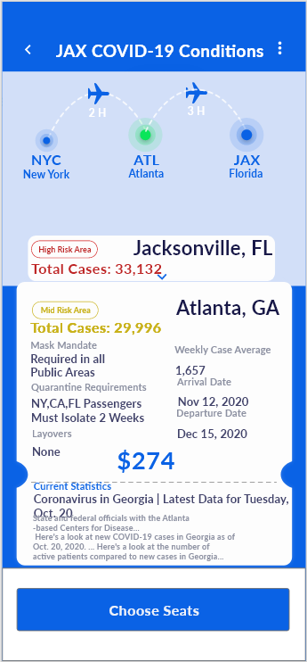
The layover conditions are shown, and the plane diagram at the top indicates that the current conditions are being shown for Atlanta

Slide 21
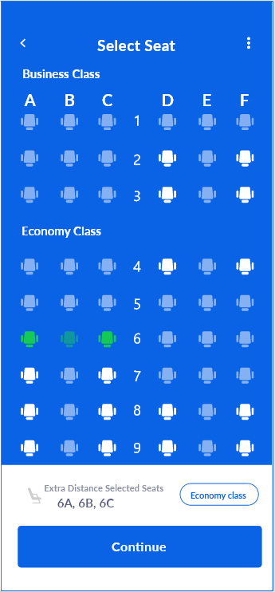
Extra distant seating allows someone to buy a row at the cost of two seats, but only one passenger is allowed in the row

Slide 22
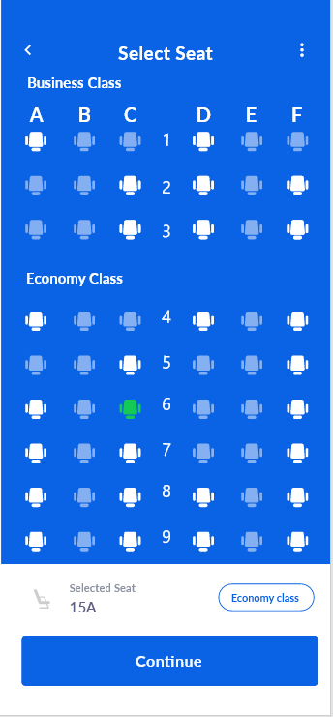
Single seats show how the center seats are never available due to covid regulations

Slide 23
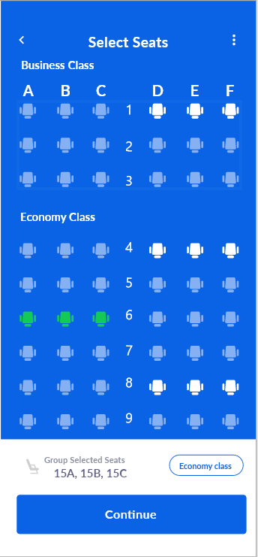
Family members are able to bypass covid regulations and sit next to each other

Slide 24
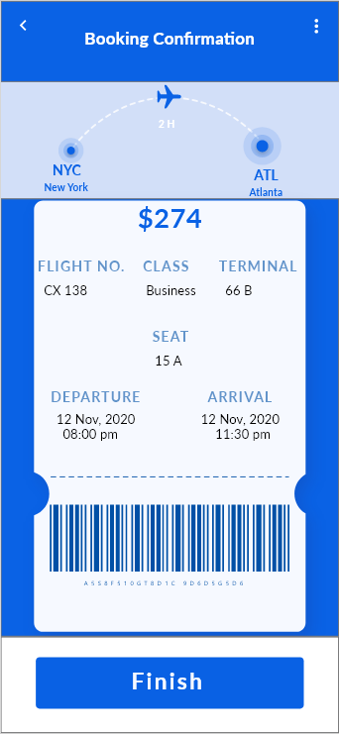
The user is shown a ticket stub of their ticket information before finishing and heading back to the home page

Slide 26
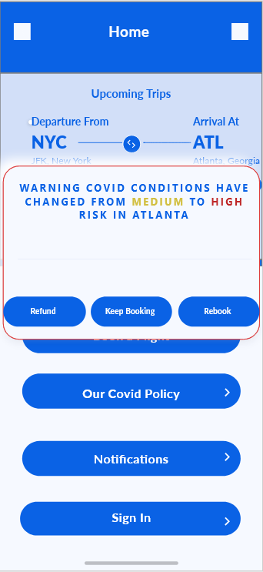
If conditions change at the destination of a booked flight, the user is given the option to refund, keep the ticket, or rebook

Slide 27
Rebooking takes the user back to a list of flights

